Slide 1
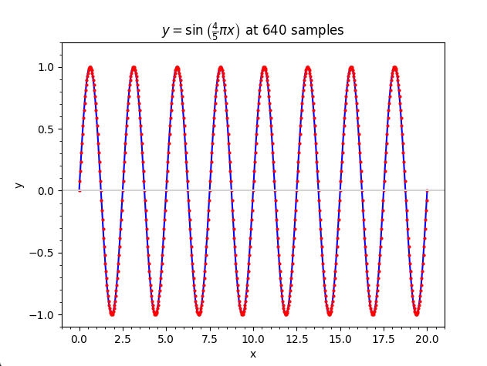
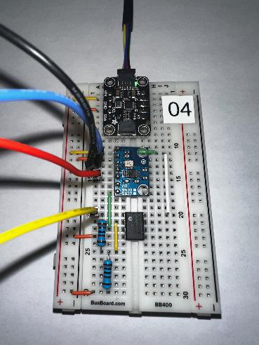
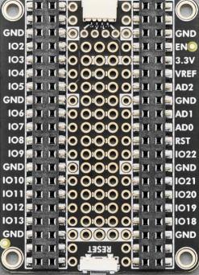
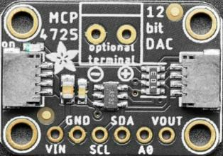
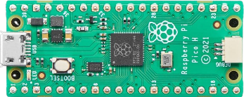
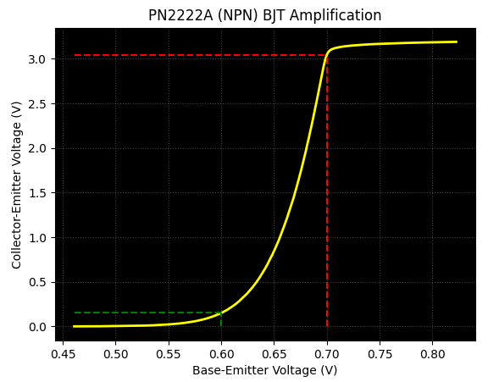

Control System Electronics 101
Using Python and Sensors to Measure Circuits
Topic 03
Digital Circuits
Dave Biersach
dbiersach@bnl.gov

Slide 2
Topic 03 – Goals
Understand Classical (Boolean) Digital Logic Circuits
Review base conversion (binary₂ ←→ decimal₁₀)
Analyze the three classical logic gates: NOT, AND, and OR
Learn how to chain multiple logic gates together in a circuit
Develop truth tables and calculate input & output states
Understand how half-adders and full-adders operate
Appreciate how memory and counters are constructed from gates

Slide 3

Base Conversion – Binary to Decimal
Position 6
Position 0
Most Significant Bit (MSB)
Least Significant Bit (LSB)
$$Weight={Base}^{Position}$$
1011001₂ = 89₁₀
← LSB
← MSB

Slide 4
Base Conversion – Decimal to Binary
Most Significant Bit (MSB)
Least Significant Bit (LSB)
% = Remainder (Mod)
// = Floor (Integer)
113₁₀ = 1110001₂
← LSB
← MSB

Slide 5
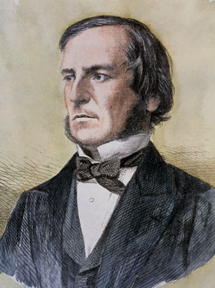
George Boole (1815 – 1864)
English mathematician
1847 published rules of symbolic logic (“Boolean Algebra”)
Only person with a data type named after him (“bool”)

Slide 6
Boolean Logic Gates
Logic Gates
Three types: NOT (inverter), AND, OR
Gates have 1 or 2 input lines and 1 output line
Input / Output lines are either:
False, F, Cold, Low, L, 0 (Zero)
True, T, Hot, High, H, 1
The left side of a truth table is counted using Base 2 to ensure every possible permutation of input states is evaluated across the entire circuit

Slide 7
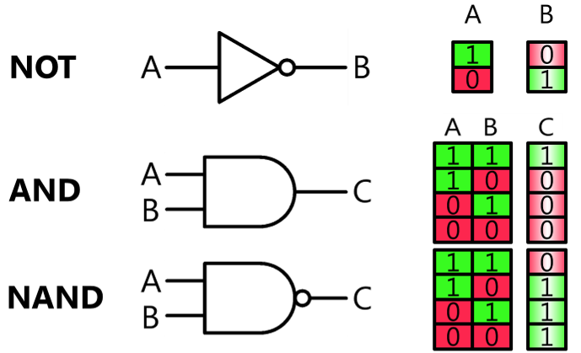
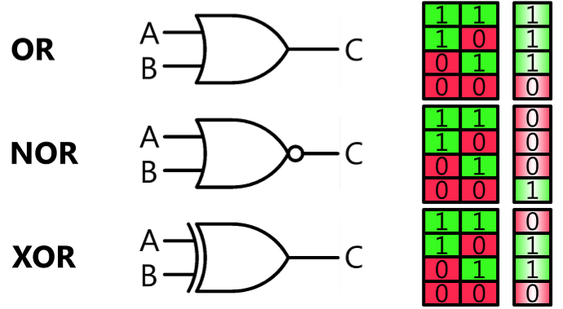
Boolean Logic Gates

Slide 8
Boolean Logic Gates
NOT (inversion) is sometimes shown as a “bar” on top
OR is a “sum” while AND is a “multiply” (modulo 2)
OR is sometimes shown as A + B
AND is sometimes shown as A • B
Circuits flow (propagate state) from “Left to Right”
The output of one gate flows into the input(s) of the next gate(s)
We can evaluate a gate’s output line only when we know the value for every input line entering that gate

Slide 9
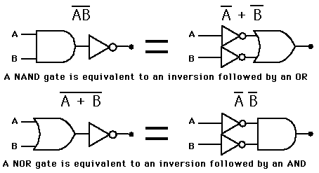
NAND and NOR Gates

Slide 10
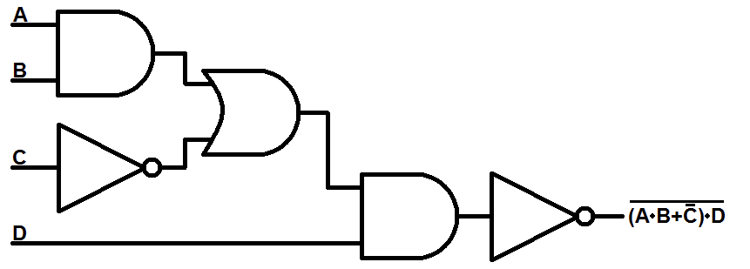
Chaining Logic Gates
AND
OR
NOT
AND
NOT

Slide 11
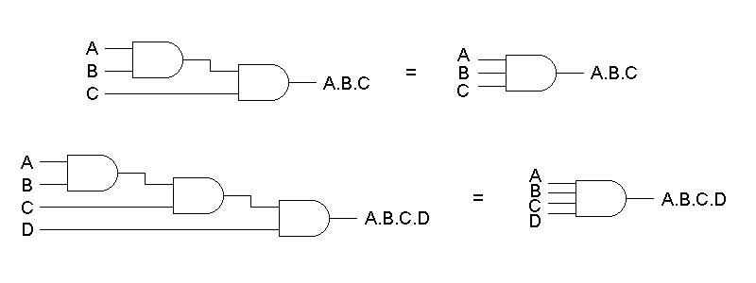
Multi-Input Gates

Slide 12
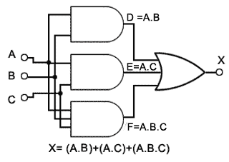
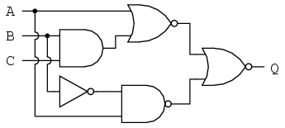
Wire Overlap vs. Intersection
Use filled circles only for electrical junction points
Carry forward the current logic state of the line into each branch

Slide 13
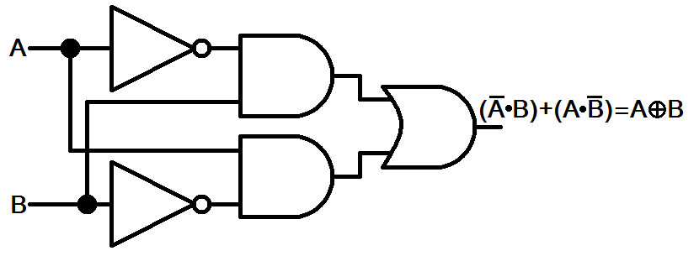
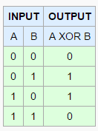
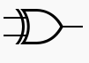
XOR Gate

Slide 14
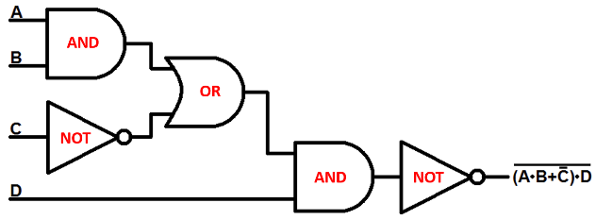
Truth Tables
1
1
1
1
1
0
1
0
1
0
0

Slide 15
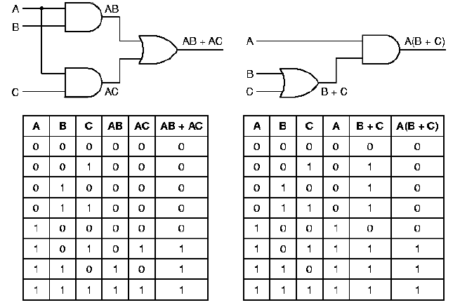
Truth Tables
$${000}_{2}=0_{10}$$
$${001}_{2}=1_{10}$$
$${010}_{2}=2_{10}$$
$${011}_{2}=3_{10}$$
$${100}_{2}=4_{10}$$
$${101}_{2}=5_{10}$$
$${110}_{2}=6_{10}$$
$${111}_{2}=7_{10}$$
With 3 input lines, there should be $2^{3}=8$ rows in the circuit’s truth table (0-7)

Slide 16
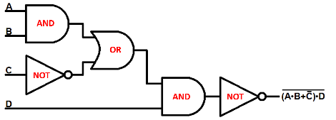

Simple Circuit
Complete this Truth Table
1
1
1
1
0
1
1
0
1
1

Slide 17
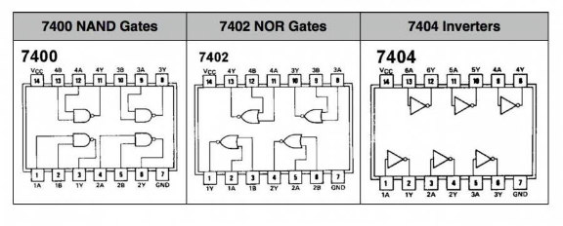
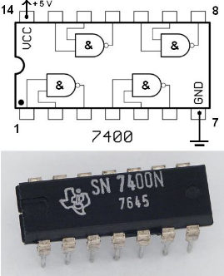
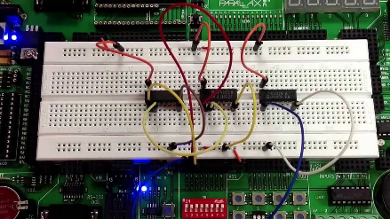
Logic Gates in the Real World

Slide 18
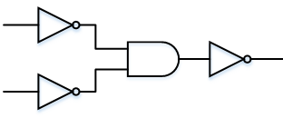
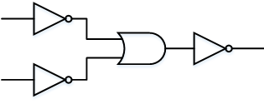
Gate Equivalence
Augustus De Morgan’s laws:
Can make an AND gate from 3 NOTs and 1 OR
Can make an OR gate from 3 NOTs and 1 AND
Invert both inputs and the output
OR from AND
AND from OR

Slide 19
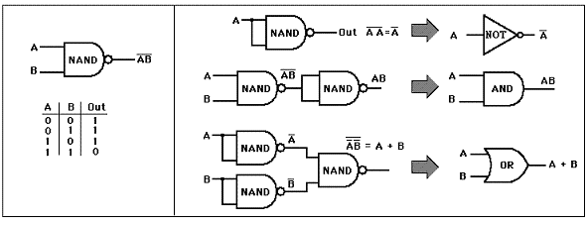
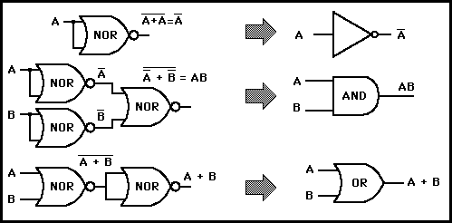
De Morgan’s Laws
We can build any circuit using just NAND or NOR gates!

Slide 20

Majority Vote Circuit
Create a truth table with input variables (A, B, C) that represent the vote (yeah or nay) of three people
Design a circuit that emits 1 as output if and only if at least 2 out of the 3 input lines are also 1
Start by making a truth table for all 8 possible input permutations
Then use AND gates to select only those input permutations that represent a valid (1/high/true) “majority” output
Then use OR gates to gather the output of those AND gates into a single output line

Slide 21
Majority Vote Circuit

Slide 22
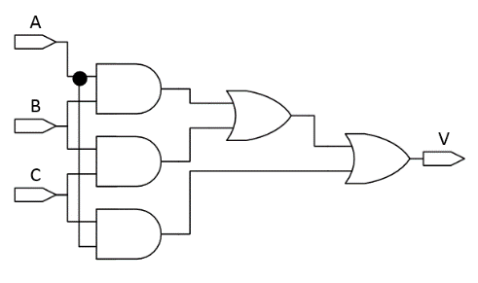
Majority Vote Circuit
1
0
0
0
0
1
1
1
1

Slide 23
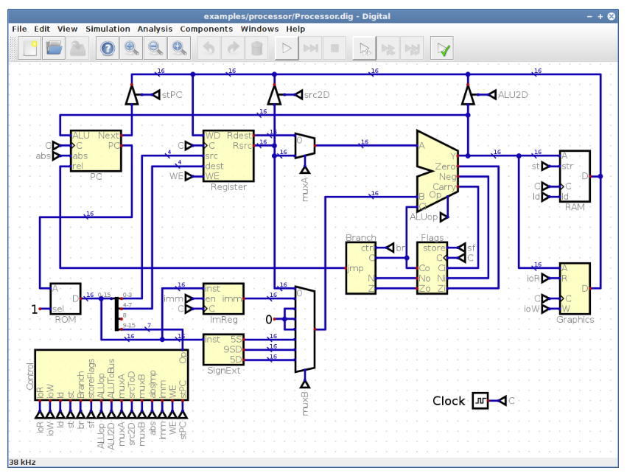
Digital Logical Simulator

Slide 24

Install a Java Development Kit
Amazon Corretto JDK Download Page
winget install Amazon.Corretto.25.JDK
①
brew install --cask corretto@25
②

Slide 25
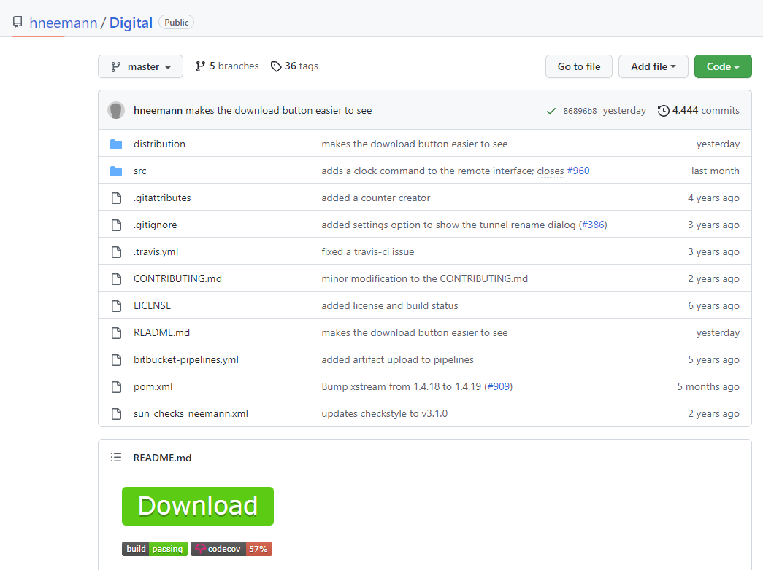
Design App – Digital Circuit Simulator
https://github.com/hneemann/Digital
Extract the ZIP file contents into your $HOME folder

Slide 26
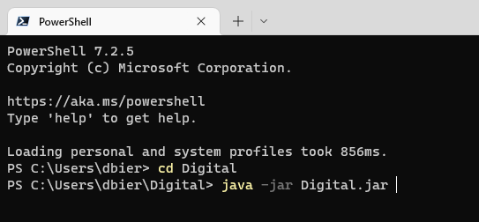
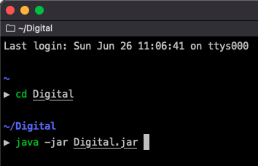
Launch Digital App
①
①

Slide 27
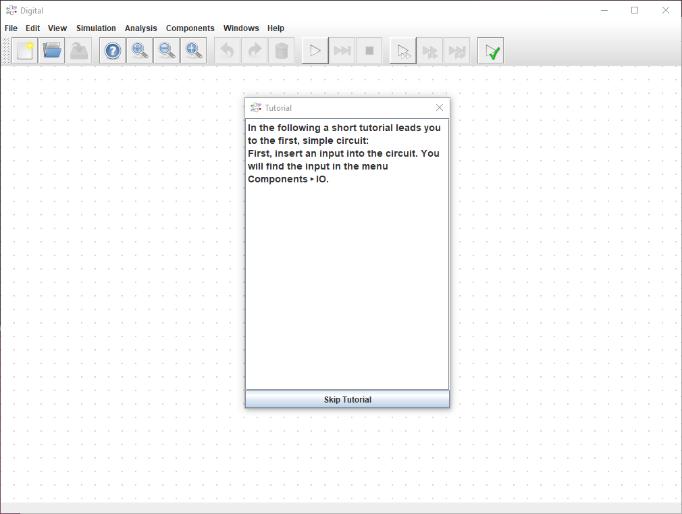
Launch Digital App

Slide 28
Simple Circuit

Slide 29
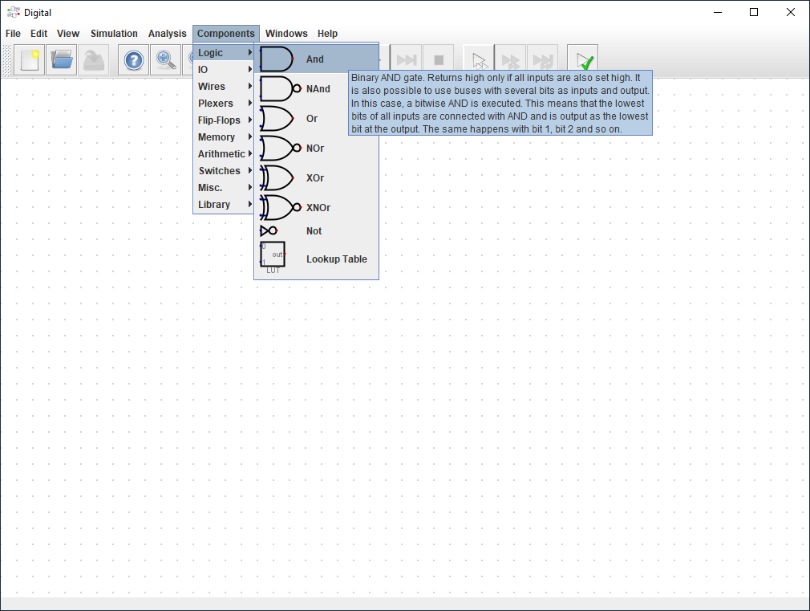
Pick AND Gate

Slide 30
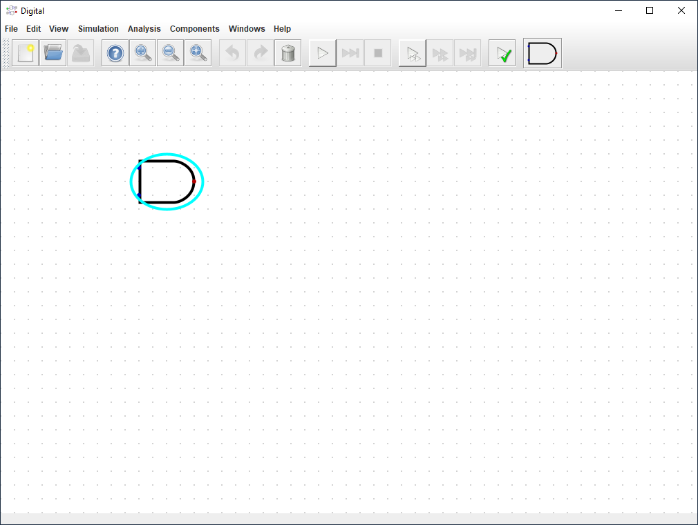
Drag AND Gate

Slide 31
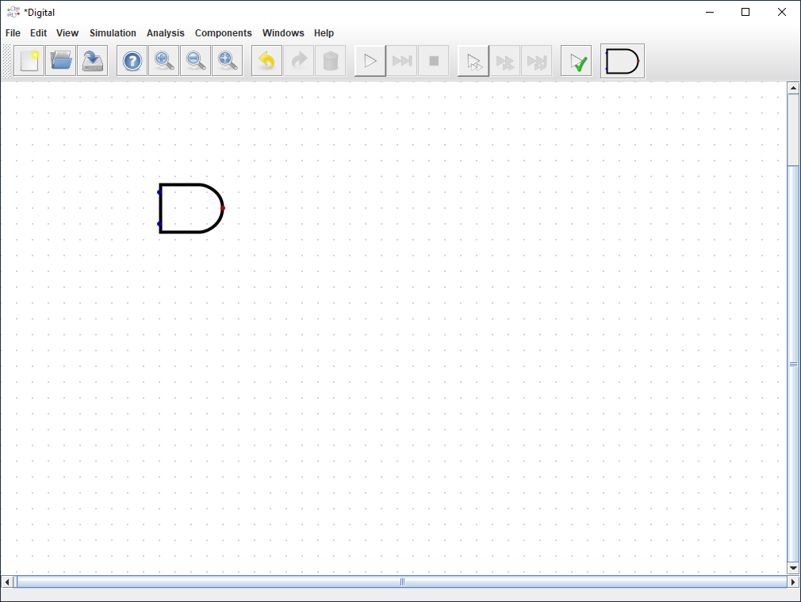
Place AND Gate
Single LEFT click to place a component

Slide 32
Pick NOT Gate

Slide 33
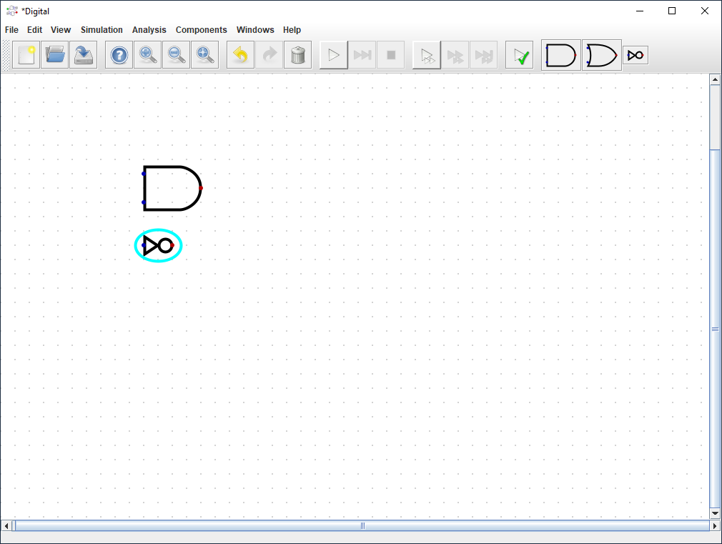
Drag NOT Gate

Slide 34
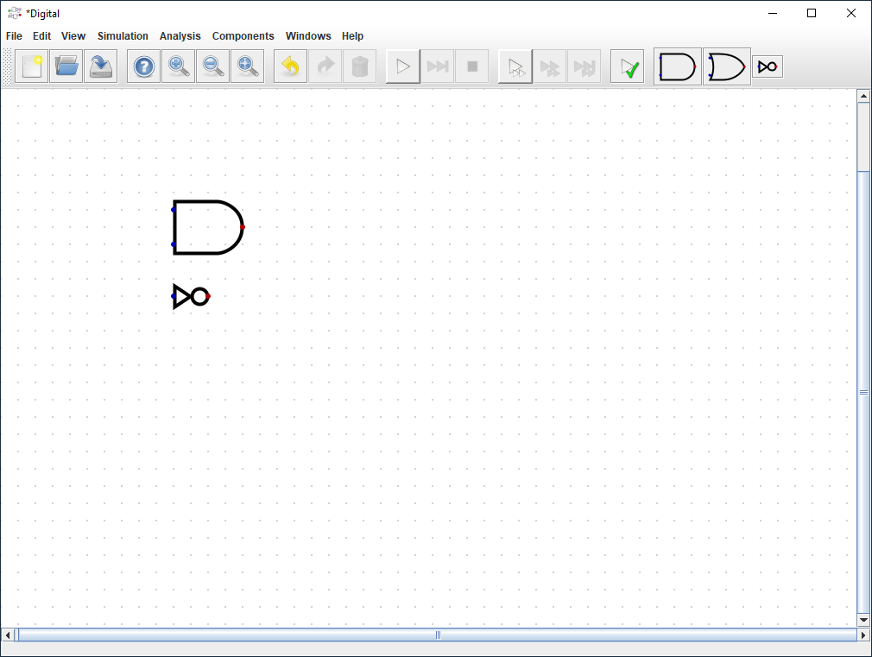
Place NOT Gate
Single LEFT click to place a component

Slide 35
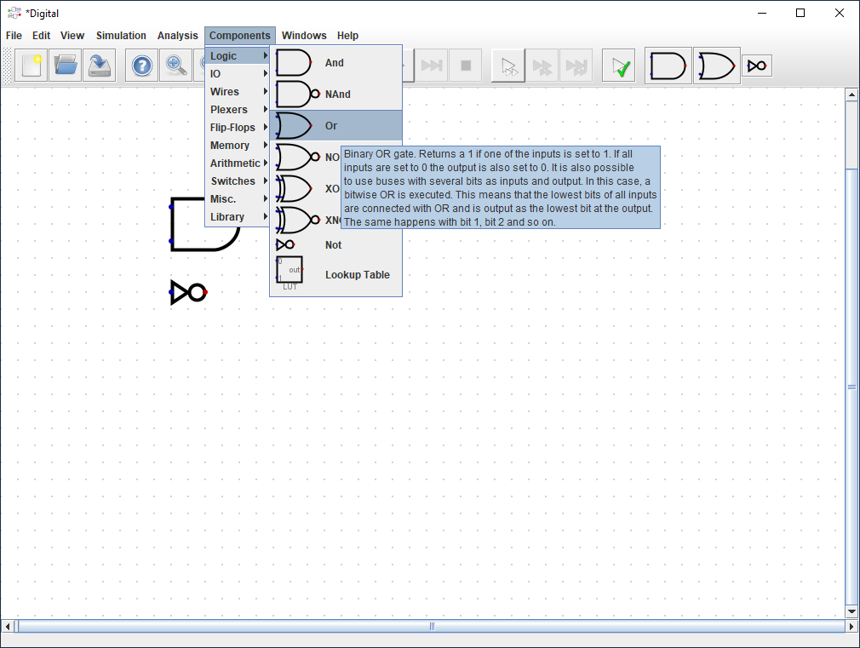
Pick OR Gate

Slide 36
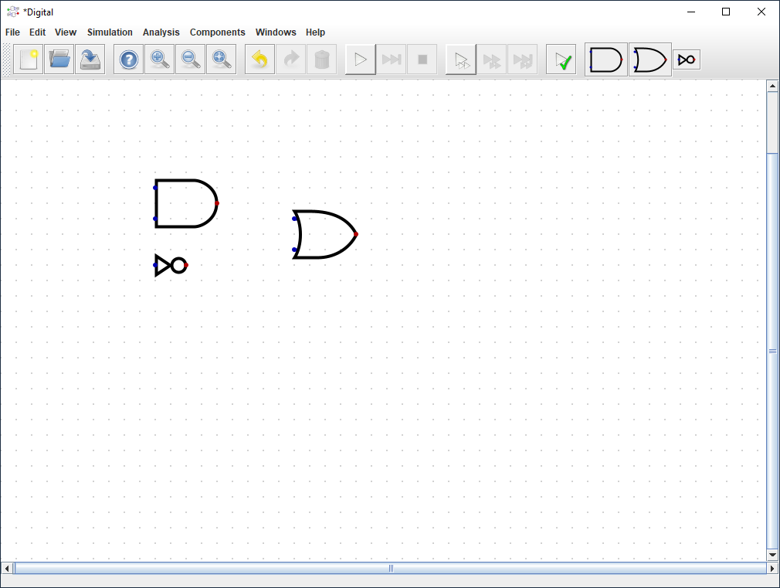
Place OR Gate

Slide 37
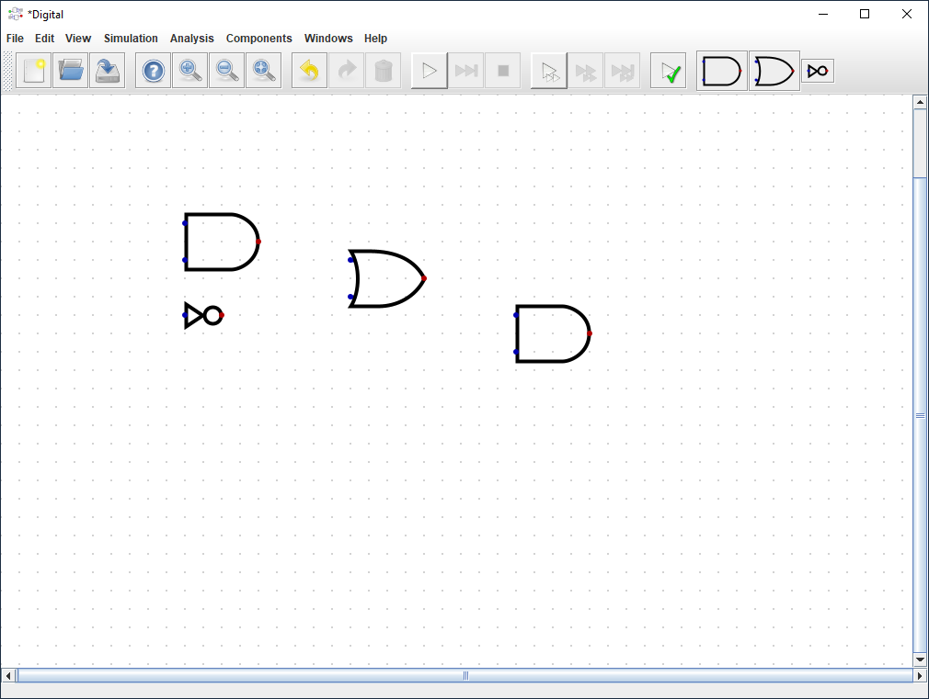
Place 2nd AND Gate

Slide 38
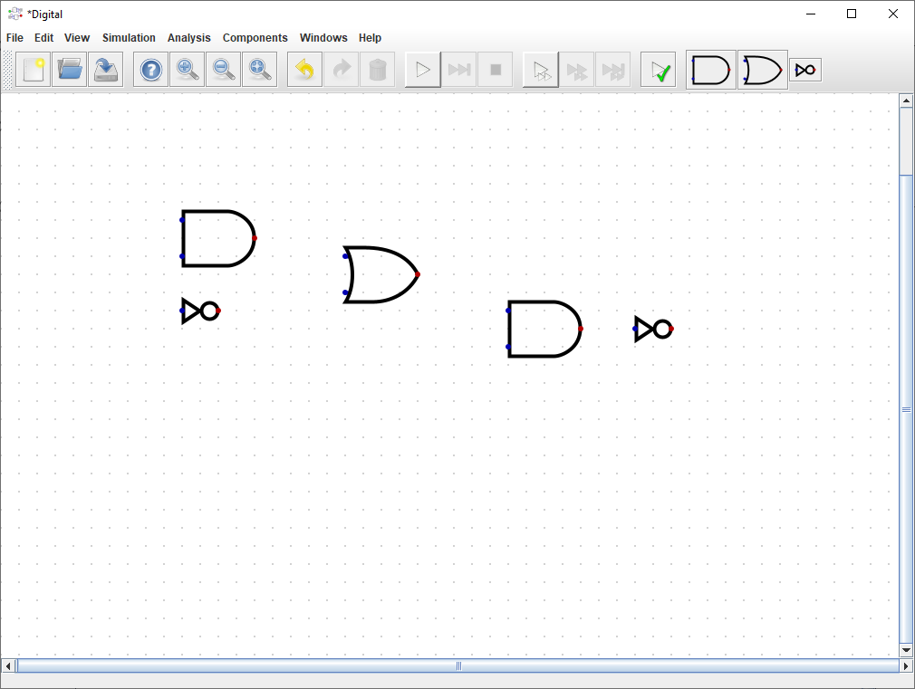
Place 2nd NOT Gate

Slide 39
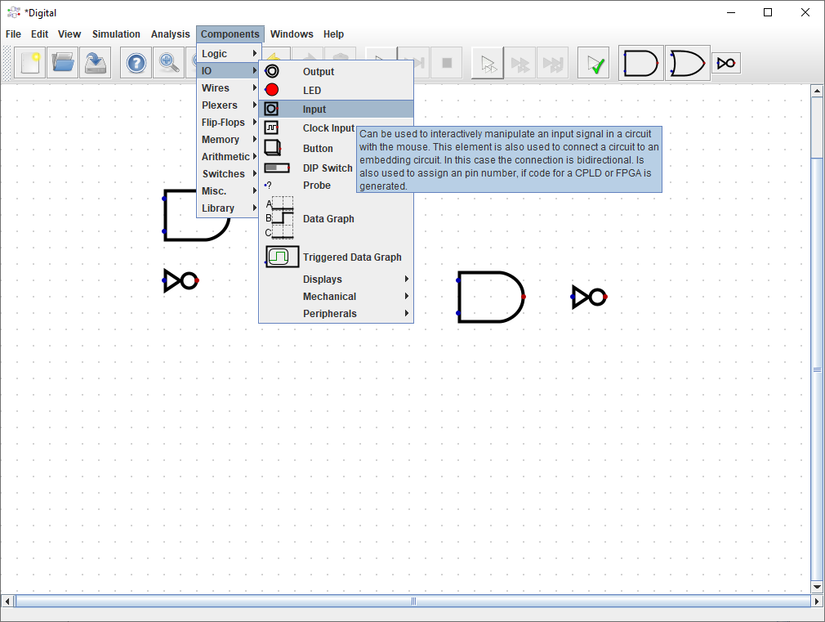
Pick Input Signal

Slide 40
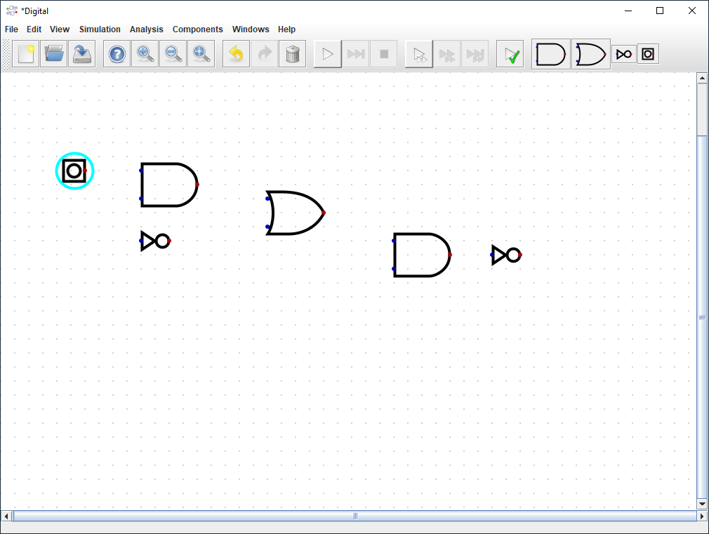
Drag Input Signal

Slide 41
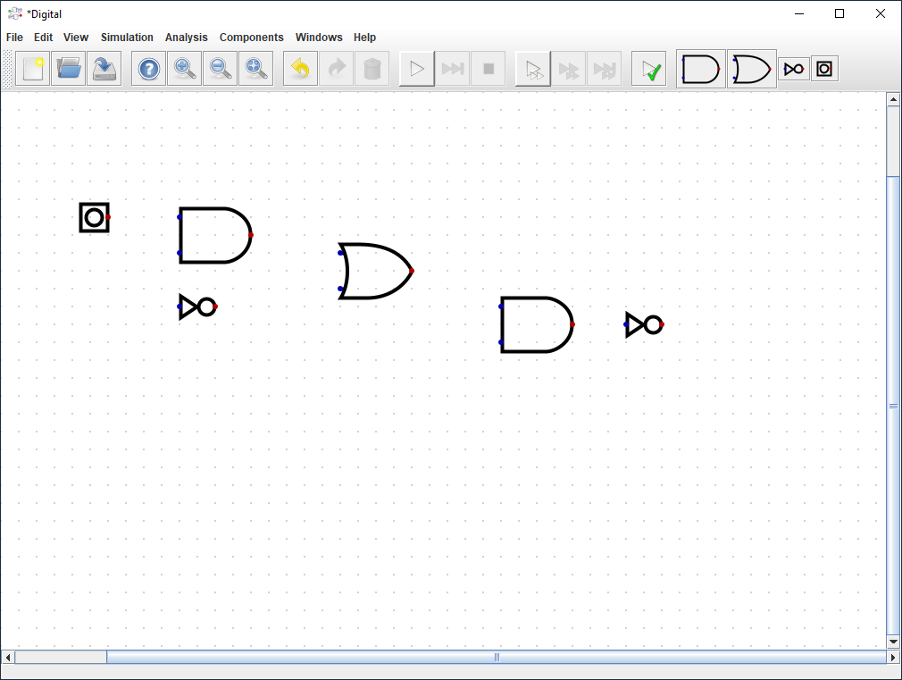
Place Input Signal

Slide 42
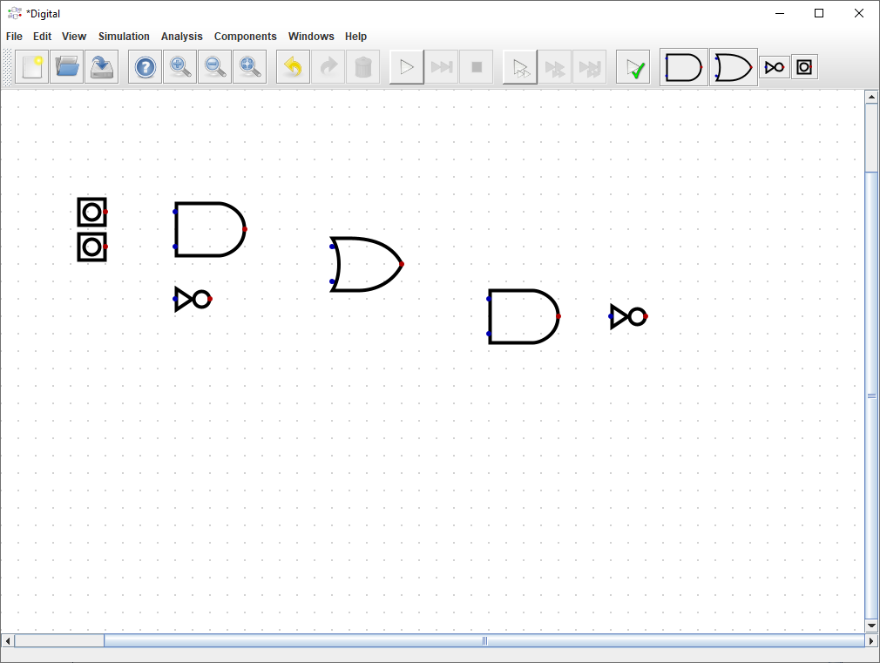
Place 2nd Input Signal

Slide 43
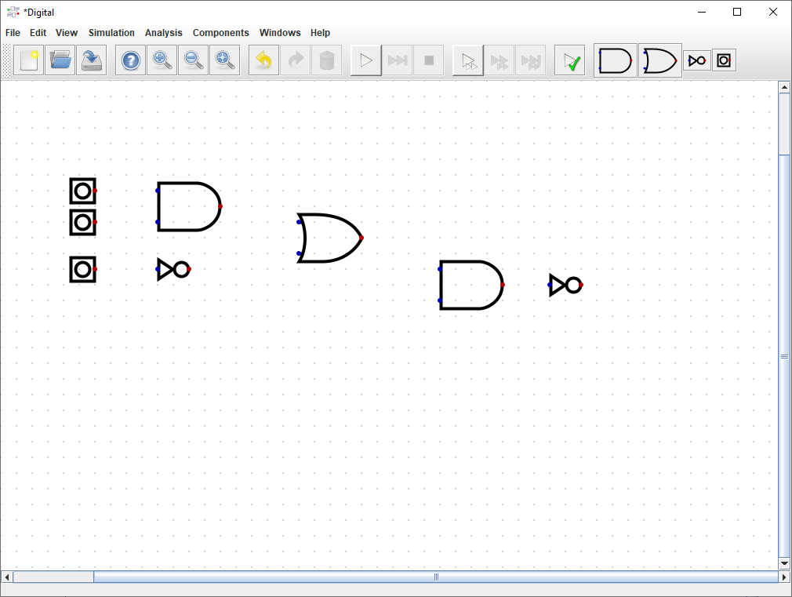
Place 3rd Input Signal

Slide 44
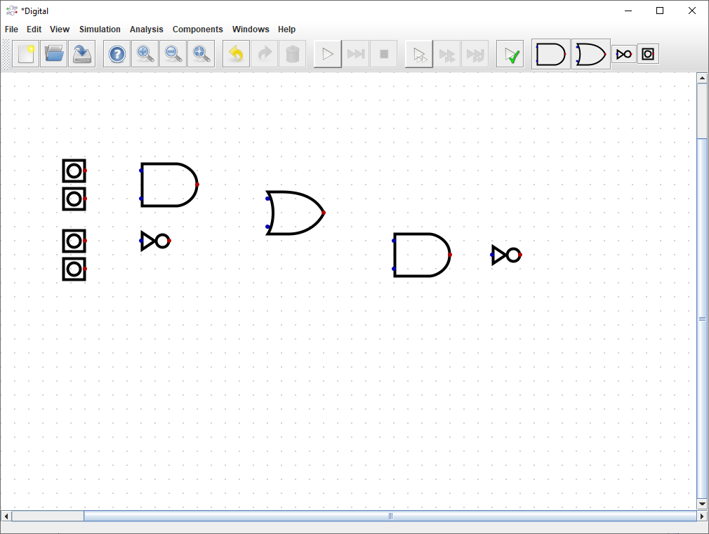
Place 4th Input Signal

Slide 45
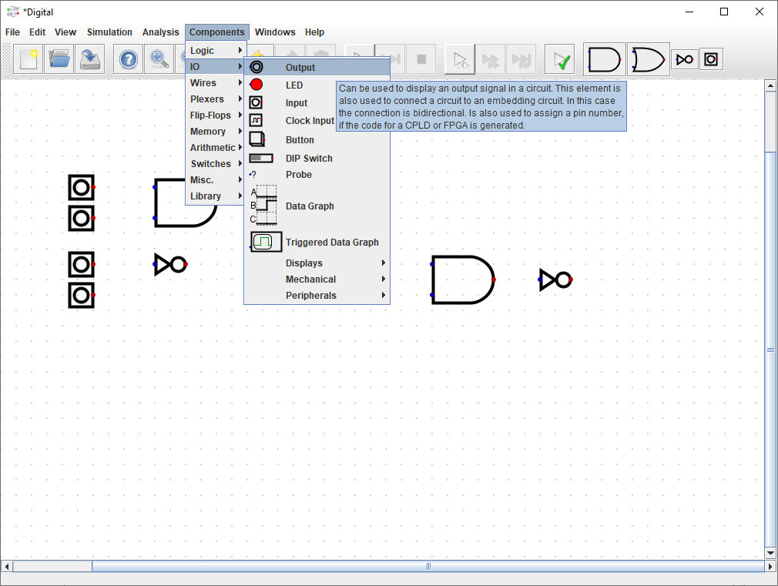
Pick Output Signal

Slide 46
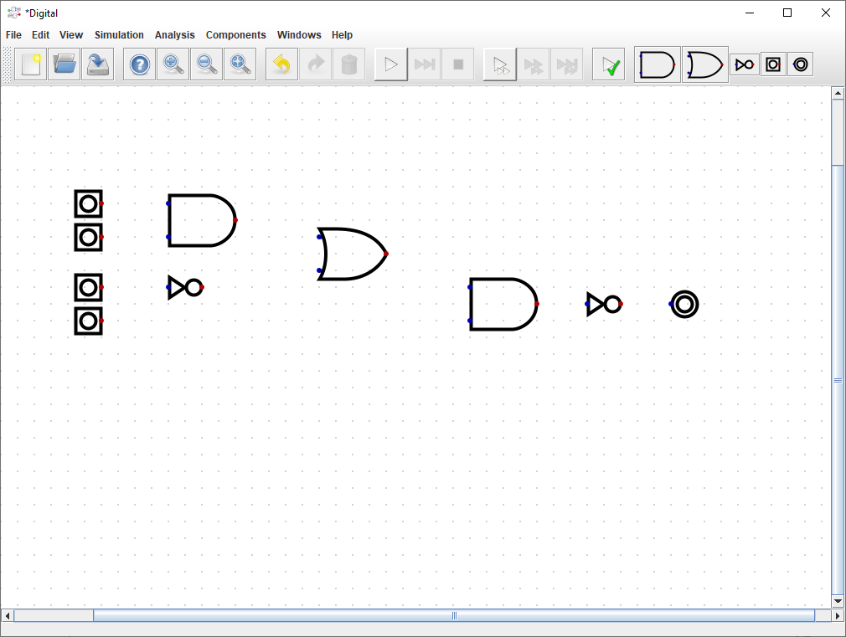
Place Output Signal

Slide 47

Wire Up 1st Input to 1st AND Gate
Single LEFT click
on the output pin of the 1st INPUT

Slide 48

Wire Up 1st Input to 1st AND Gate
Move mouse leftward
(while NOT holding LEFT button)
to the top input pin of the
1st AND Gate

Slide 49

Wire Up 1st Input to 1st AND Gate
Single LEFT click (to end wire drawing mode) and the wire should turn dark blue

Slide 50

Wire Up 1st Input to 1st AND Gate

Slide 51

Wire Up Output of 1st AND to 1st OR Gate

Slide 52

Wire Up Output of 1st AND to 1st OR Gate
Moving mouse DOWN
makes the wire
"turn" the corner

Slide 53

Wire Up Output of 1st AND to 1st OR Gate
Single LEFT click starts a new wire direction

Slide 54

Wire Up Output of 1st AND to 1st OR Gate
Single LEFT click (to end wire drawing mode) and the wire should turn dark blue

Slide 55

Wire Up 3rd Input to 1st NOT to 1st OR Gate

Slide 56

Draw Bounding Rectangle to Select Wire(s)
After selecting the wire press DEL key

Slide 57

Draw Bounding Rectangle to Select Wire(s)
After selecting the wire(s) press DEL key

Slide 58

Wire Up OR Gate to 2nd AND Gate

Slide 59

Wire Up 4th Input to 2nd AND Gate

Slide 60

Wire Up 2nd AND to 2nd NOT Gate

Slide 61

Wire Up 2nd NOT to OUTPUT Signal

Slide 62

Label 1st Input Signal
Right click on Input Symbol

Slide 63

Label 2nd Input Signal
Right click on Input Symbol

Slide 64

Label 3rd and 4th Input Signals

Slide 65

Label Output Signal
Right click on Output Symbol

Slide 66

Label Output Signal

Slide 67

Select Analysis Menu Option

Slide 68

Generate Truth Table for Circuit

Slide 69

Save Circuit File

Slide 70


Save Circuit File

Slide 71


Open Majority Vote Circuit

Slide 72

Open Majority Vote Circuit

Slide 73

Generate Truth Table for Majority Vote Circuit

Slide 74

Generate Truth Table for Majority Vote Circuit

Slide 75


Binary Addition
Carry bits
Sum bits

Slide 76

Full Adder Circuit using NAND gates
Carry-In from the prior (rightward) column
Carry-Out to the next (leftward) column

Slide 77

Chaining Full Adders with Ripple Carry
1 0 1 = 5
1 1 0 = 6
2
10
2
10
1
1
0
1
1
0
1
0
0
1
0
1
1
0 1 1
= 11
2
10

Slide 78

1 Bit Memory : Set-Reset Latch
The key was to send the output back into the input!

Slide 79



1 Bit Memory: A clocked J-K Flip-flop
A J-K flip-flop can be set/reset/toggled only during the rising edge of the clock signal
When the clock is low a latch maintains its prior output value

Slide 80



CD4027 Dual J-K Flip-Flop
+5V
CD4027BE
GND

Slide 81


A 4-Bit Counter Using Clocked J-K Flip-Flops
+5V
+5V
+5V
+5V
LSB
MSB

Slide 82

Open 4_bit_counter.dig Circuit

Slide 83

Run 4_bit_counter.dig Circuit

Slide 84

Check 4_bit_counter.dig Circuit
The LEDs should cycle from 0 to 15
OFF-OFF-OFF-OFF = 0000 = 0
ON-ON-ON-ON = 1111 = 15
And then wrap around to zero and continue counting by 1 each clock tick

Slide 85


Reading 3 bits from a memory with 4 addresses
Consider that a typical 256 GB
smart phone has
$2×{10}^{12}$
bits of memory!
Address Lines
This 12-bit memory
is made from a 4 x 3 matrix of flip-flops
Data Lines

Slide 86

A Computer = An Adder with Memory

Slide 87

Apollo Guidance Computer

Slide 88


Apollo Guidance Computer

Slide 89
Topic 03 – Now You Know…
Digital Logic Circuits
All computers are made from chains of simple logic gates
NAND and NOR gates are universal → They can make all other classical Boolean logic gates!
How a computer performs arithmetic = full adders
Subtraction is just addition with inverted logic
Multiplication is just repeated addition
Division is just repeated subtraction
How a computer stores numbers in memory = flip-flops
Four gates make a bit, and eight bits make up a byte
Imagine how many gates are in your 128GB smartphone!

Slide 90
Task 03-01
Using the Digital App, create a circuit file called full_adder.dig
Using only 1 OR, 2 AND, 2 XOR gates, plus five I/O pins, design a FULL ADDER circuit
The circuit has 3 input lines, and 2 output lines to indicate the sum and if there needs to be a carry to the next column
Verify your circuit by having Digital create a truth table
Upload to the BNL QIS101 SharePoint site your circuit (.dig) file

